Slide 1
BEABLE END-OF-YEAR STUDENT CELEBRATION!
Recognizing Your Success This School Year
Notes:
Before we walk through a demo of Beable, I would like to take a few minutes to give you some background on Beable, that will provide you with some context for the approach of the product. Covid has been a traumatic and challenging time for both teachers and students. Many students have lost instructional time and have shown limited growth in literacy. Beable is about supporting schools with rescue and recovery through the development of life ready literacy.

Slide 2
WELCOME TO YOUR BEABLE END OF YEAR CELEBRATION
Notes:
At the heart of the Beable IQ engine are three proprietary tools: The Learner Record, the Forecaster, and the Accelerator.

Slide 3
REFLECTING ON YOUR ACHIEVEMENTS! A LOOK BACK THROUGHOUT THE YEAR
Notes:
At the heart of the Beable IQ engine are three proprietary tools: The Learner Record, the Forecaster, and the Accelerator.

Slide 4
Wow!
Teachers, use this space to add screenshots of reports showing positive growth

Slide 5
LITERACY VICTORIES!
Together you have has completed over
And completed
XX
XX
Lessons !
Reading Challenges!
Notes:
At the heart of the Beable IQ engine are three proprietary tools: The Learner Record, the Forecaster, and the Accelerator.

Slide 6
CONTEST WINNERS
List of school-wide and national winners- Available by request
This school-year you competed in # contests against over x students nationwide!
Congratulations to [school name] winners!
Carson Carney
Simeon Russell
June Higgins
Draven Irwin
Adriel Chang
Eliana Fields
Collin Hartman
Dennis Lindsey
Adriel Kelley
Elsa Velez
Giovanna Li
Jessie Dougherty
Simeon Russell
June Higgins
Draven Irwin
Adriel Chang
Eliana Fields
Collin Hartman
Dennis Lindsey
Adriel Kelley
Elsa Velez
Giovanna Li
Jessie Dougherty
Notes:
At the heart of the Beable IQ engine are three proprietary tools: The Learner Record, the Forecaster, and the Accelerator.

Slide 7
congratulations
Insert your student names here, or create one slide for each student name
Carson Carney
Simeon Russell
June Higgins
Draven Irwin
Adriel Chang
Eliana Fields
Collin Hartman
Dennis Lindsey
Adriel Kelley
Elsa Velez
Giovanna Li
Simeon Russell
June Higgins
Draven Irwin
Adriel Chang
Eliana Fields
Collin Hartman
Dennis Lindsey
Adriel Kelley
Elsa Velez
Giovanna Li
Jessie Dougherty
Adriel Chang
OR
Notes:
At the heart of the Beable IQ engine are three proprietary tools: The Learner Record, the Forecaster, and the Accelerator.

Slide 8
YOU
are learning

Slide 9
YOU
are growing

Slide 10
YOU
are the Future

Slide 11
YOU
Can be Anything

Slide 12
Reach
For the Stars

Slide 13
Your Future has unlimited possibilities

Slide 14
Congratulations
Class ____

Slide 15
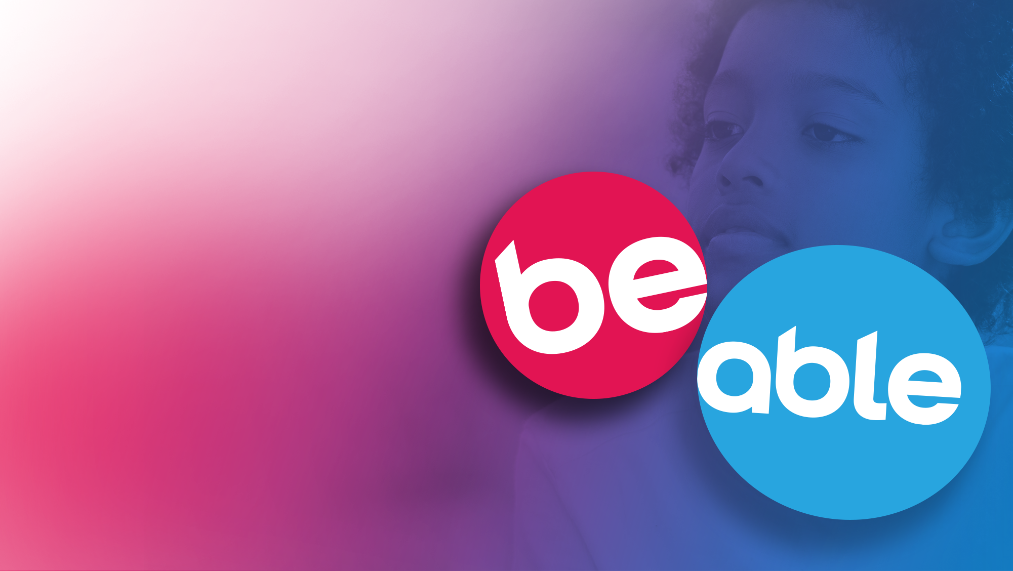
Thank you for allowing Beable to be a part of your success.

